Slide 1
Ecommerce
Carlos Alvarez, Ryan Criswell, Joseph Howard, Aspen Pratt, Logan Stoltz, Mamdouh Zayed

Slide 2
(notes - not included in presentation)
A quick 5 minute presentation focusing on the technical side of what we’re doing and how we’re going to do it. We should each write a short segment to present based on our group assigned roles, for example UX will present about abstract site structure while front end will talk about techniques and frameworks we’ll use to achieve it, backend talks about database schemas etc. Date of presentation is Monday the 30th!

Slide 3
Front End - Motion
Many modern sites use interactive motion to entice users, which is especially important for ecommerce - an attractive, responsive website sells more than a plain text document!
jQuery
Allows easy procedural animation through a javascript interface, interacting directly with the DOM to manipulate HTML elements
CSS Animations and Transitions
Allows for very simple animations and interactions, for example on mouseover. More limited than jQuery but cheaper on the hardware
IntersectionObserver API
Inspired by Etsy, this can be used in conjunction with CSS Transitions to create infinite scrolling with a nice visual flair, as well as lazy-loading images to improve performance.

Slide 4
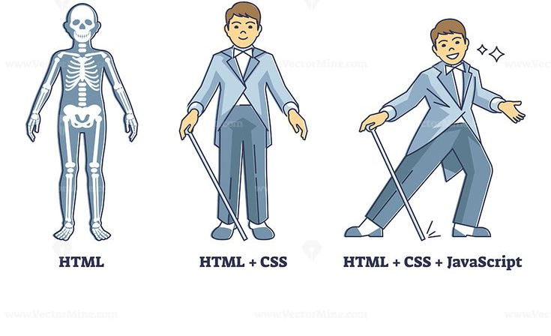
Front End - General layout
As mentioned in the previous slide we want to entice our users with a very appealing webpage. Having a very user-friendly layout for a website that is easy to navigate can help achieve this. In our case we want:
Good Typography
Font style and general appearance
Organization of graphic elements
URL’s, title , price and a description of the graphic that can be reused for other similar products
Colors
Having a color palette that is used throughout the webpage

Slide 5
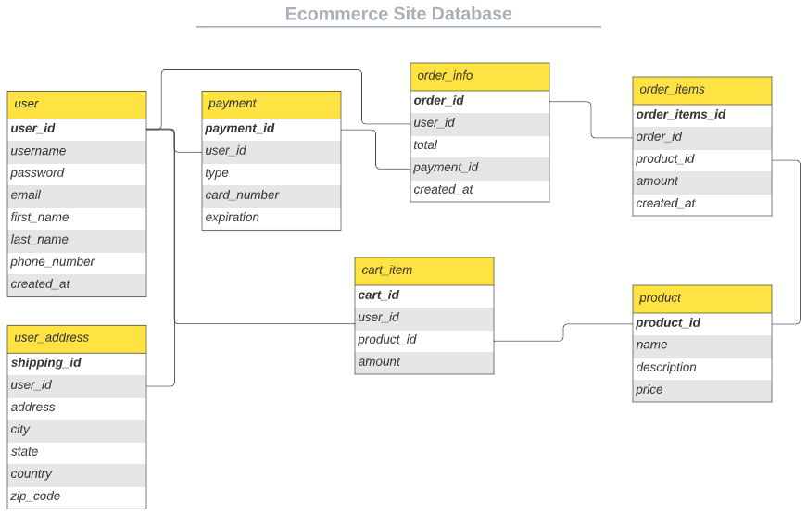
Backend - Database
RBDMS - MySQL
Stores data related to:
User login
Shipping address
Payment
Products
Orders
Cart

Slide 6
Backend - Requests and Server side
The structure that makes a website respond to requests and to databases as mentioned. You come up with the best structure (app) that sits on a server to process what is given from the webpage.
An authentication system for users (JSON Web Tokens)
Maybe a sort of notification/news reminder (Email, SMS, push Notifications)
Error/Request/Response logging to deal with user mishaps
Security measures to help resist dos and other forms of attacks

Slide 7
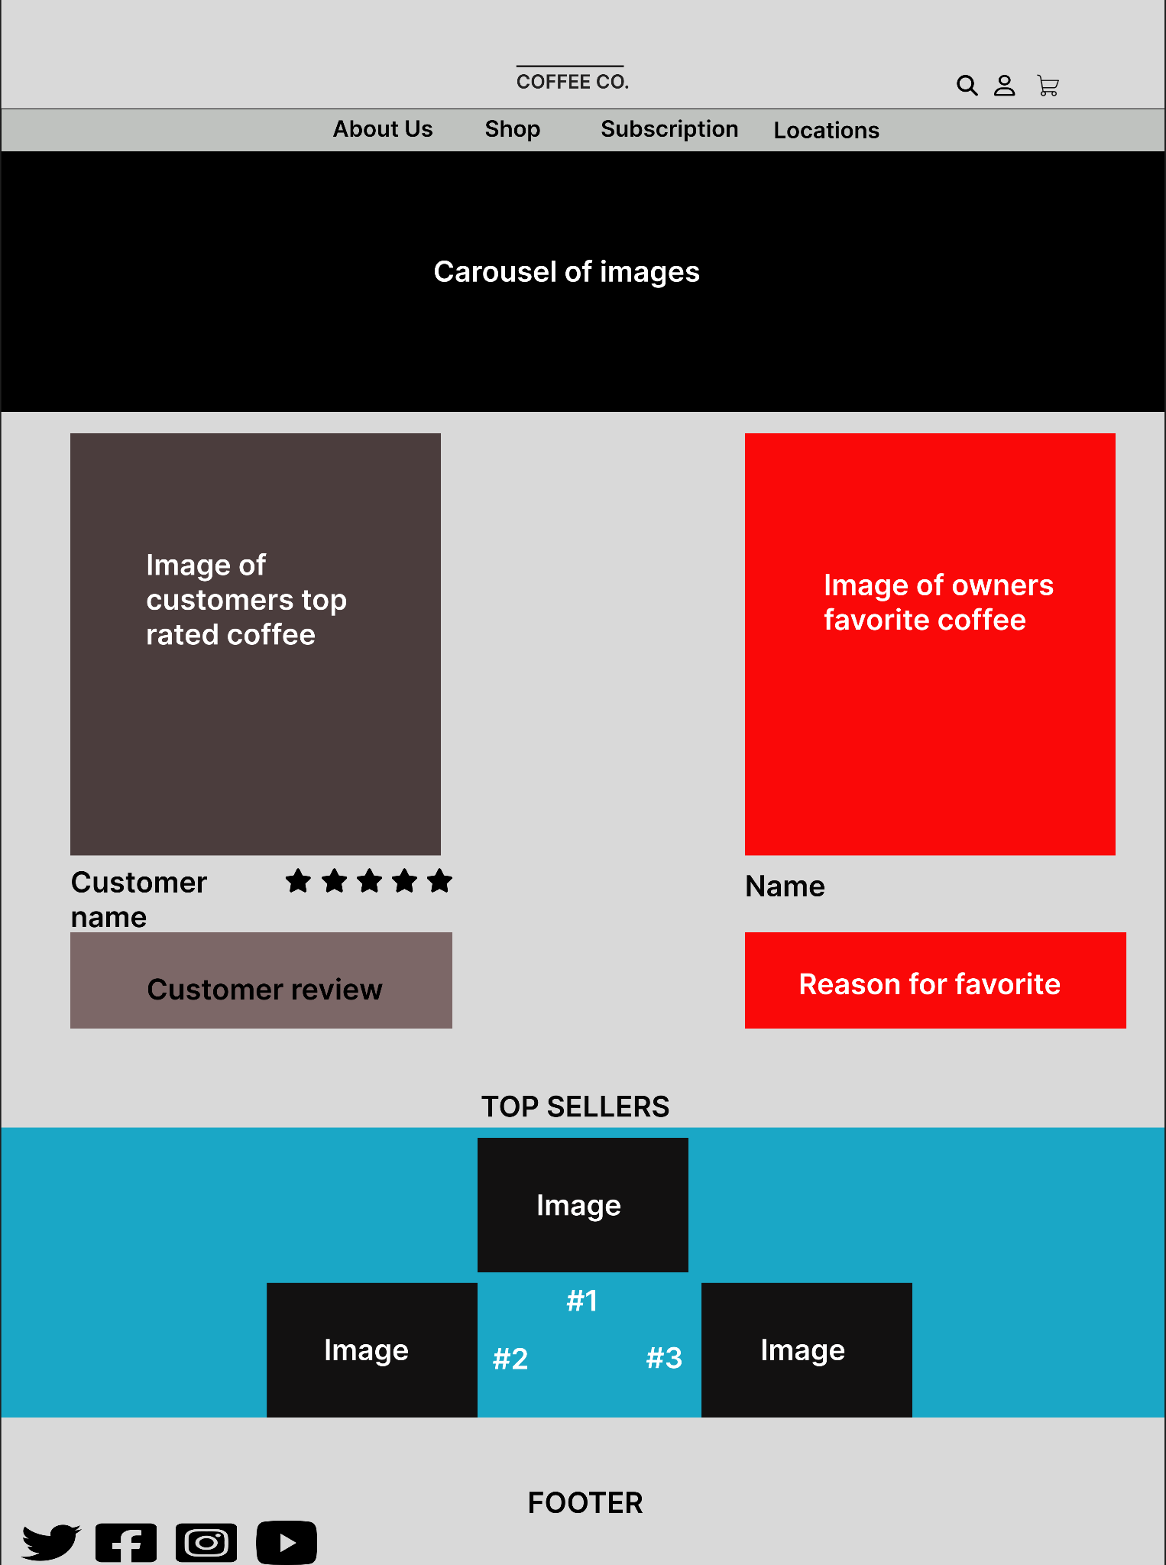
UX
When it comes to ecommerce websites the biggest thing is having a
design that catches the users attention and makes them want to stay
on the site
Figma
Use figma to create mockups such as the one on the right
Research
Look at popular sites and see what layouts they have and colors
Flow
A consistent flow that does not pack to much information on one
portion of the site

